Slide 1


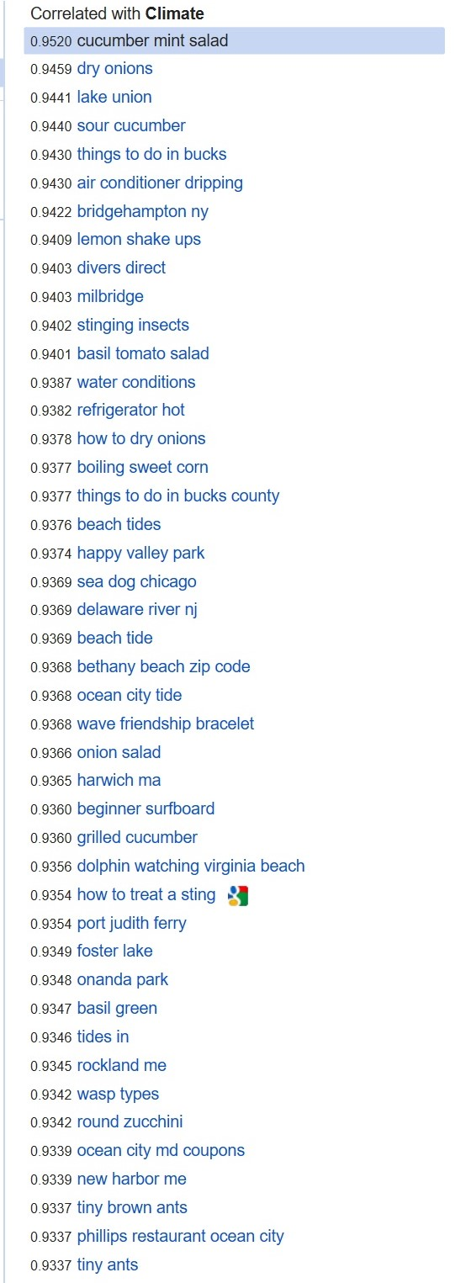
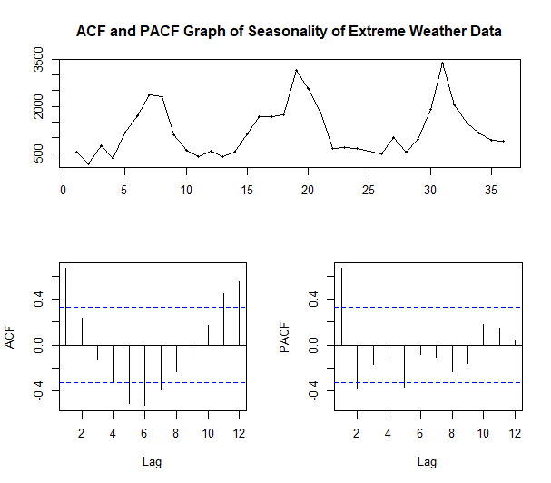
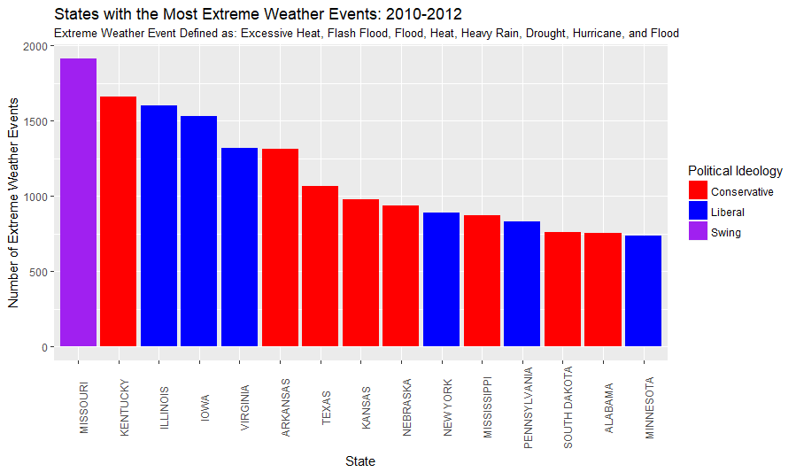
How Abnormal Temperatures Affect Climate Change Attitudes and Behaviors
Kristopher Nichols
University of Chicago
Abstract
The current study looks to investigate how abnormal temperatures affect the number of Google searches for climate change across Democratic, Republican, and swing states and may alter climate change behavior as measured by Google search data.
Data / Methods
Results
Results/Discussion
Overall, the modeling of Google correlates with extreme weather data is promising – the Google correlate exhibit clear seasonal patterns of seasonality which is to be expected from extreme weather data that spikes in the summer months.
Further Analysis is needed with the Google Trends data as supplementary data to help paint a clearer picture of the relationship between Google searches about climate change
These data can be used to supplement available survey data and build stronger models
Weather Data
Extreme weather as designated by the National Assessment Council:
Excessive heat, Flash floods, Flood, Heat, Heavy rain, Hurricane
I analyze three states with the highest and lowest amount of extreme weather in order to discover any ideological differences in the interaction between extreme weather and Google search data
States used: (High: IL, KY, MO) (Low: RI, WY, FL)
Political Data
I calculate conservativism/liberalism by taking state-level data from the two closest presidential elections: 2008 and 2010.
States with highest combined voting percentage for conservative candidate were coded as conservative
those with the lowest were coded as liberal
those within .05 of 1 (i.e., .5 percent on average each year) were coded as swing states
Google Search Data
I implement the usage of Google Correlate to find Google queries that are correlated with other Google queries and can also find queries that are correlated with user-supplied data. Stepwise regression is used to select correlates
I determine the Google Search Terms used in Google Trends with the use of SEMRush data cross referenced with other Google search volume 3rd party sites
Auto-Regressive Integrated Moving Average (ARIMA)
I use seasonal time-series modeling for the results – ARIMA modeling is well validated within the literature and appropriate for these data to its handling of seasonal data
Figure 1 & 2. Seasonality of Extreme Weather Data; Google Correlates of Extreme Weather Data
Background
Climate Change Attitudes
Majority of American citizens support governmental intervention in limiting carbon output (Leiserowitz, Maibach, Roser-Renouf, & Feinberg, 2010; Leiserowitz, Maibach, Roser-Renouf, Feinberg, & Howe, 2013)
Election results implicate a lack of concern for mitigating the effects of climate change (Popovich, Schwartz, Schlossberg, 2017)
Climate change attitudes have been found to vary as a function of recent abnormal weather patterns (Bergquist, & Warshaw, 2017; Brooks, Oxley, Vedlitz, Zahran, Lindsey, 2014)
Past Methodologies
Survey methods are limited in external validity due to:
Potentially crippling non-response bias (Brehm, 1993)
Observer-expectancy bias
Reactance
This study looks to correct these problems inherent in self-report measures using Google search data
HYPOTHESES
States with high amounts of abnormal weather will have significantly more general Google searches about climate change and global warming
When Google searches for “climate change not real” or “global warming not real” are included in analyses, these data will control for the majority of variation in Republican states.
Cognitive dissonance mechanism emerges by which participants initially Google “climate change not real” to soothe their dissonance.
Limitations
Results possible biased by relatively short time-series (2010-2012)
Need Google Trends data to interpret individual state Google search patterns
Figure 2 & 3. Performance of two selected stepwise regressors in ARIMA (0, 0, 0) model
References
Bergquist, P., & Warshaw, C. (2017). Beyond politics: Climate concern responds to changing temperatures in the American states. MIT Urban Planning.
Brehm, J. (1993). The Phantom Respondents. Ann Harbor: University of Michigan Press.
Leiserowitz, A., Maibach, E. W., Roser-Renouf, C., & Feinberg, G. (2010). Climate Change in the American Mind: Americans Global Warming Beliefs and Attitudes in June 2010. SSRN Electronic Journal.
Leiserowitz, A., Maibach, E. W., Roser-Renouf, C., Feinberg, G., & Howe, P.(2013). Climate Change in the American Mind: Americans Global Warming Beliefs and Attitudes in April 2013. SSRN Electronic Journal.
Popovich, N., Schwartz, J., & Schlossberg, T. (2017) How Americans Think About Climate Change in Six Maps. The New York Times. Retrieved from https://www.nytimes.com/interactive/2017/03/21/climate/how-americans-think-about-climate- change-in-six-maps.html
ME | RMSE | MAE | MPE | MAPE | MASE | ACF1
-7.547543e-13 | 0.2253717 | 0.1993406 | -0.003263839 | 0.02325411 | 0.0003987267 | -0.1063307
σ²= 0.05541 | log likelihood=2.56
AIC=2.88 | AICc=4.17 | BIC=9.22
ARIMA Model (0,0,0): White Noise
Initial modeling is strong with a quite strong ME and standard deviation
Concerns for overfitting exist, although there are only two regressors the time period analyzed was shorter than will be analyzed in final paper, perhaps contributing to strangely strong modeling numbers
Finally, there is a fairly large spike at lag 1 and smaller spikes at lags 2 and 5 that will need to be corrected in final analyses
Contact Information
Kristopher Nichols: nicholskl3@uchicago.edu

